Slide 1

Paython Analysis Project
Churn Prediction
Shira Saroossi
Dror Givon
Hani Exterman 73593977
March 2022

Slide 2
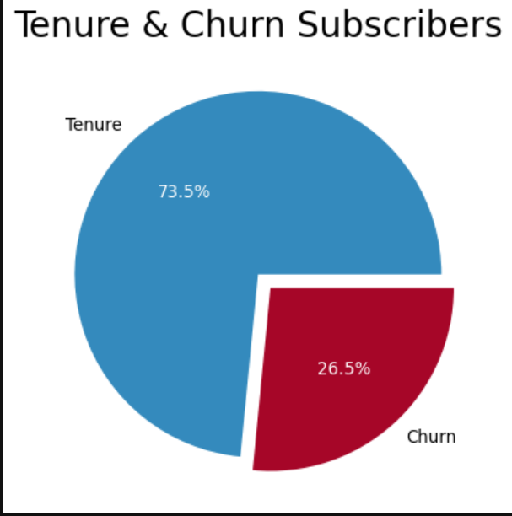
The Problem: More than 26% Churn
Our Aim is to reduce churn
We will use the data to identify correlations of the different parameters and Churn
We will use the data to predict Churn based on the given parameters (features)

Slide 3
Data Description
20
Features
1Label Churn
26.5%
Churn
Train
Test
Prediction Model
5,557
7,043 examples
1,486

Slide 4

Data Inputs - Features
Category | Input | Type | Comments / Feature Engineering
Customer Info | customerID | type should be integer | Key
 | gender | Gender | Mail, Female
 | seniorcitizen | 0-No 1-Yes
 | partner | Yes/No
 | dependents | Yes/No
 | tenure | Number of subscribing months | We grouped in into 3 categories
Services Packages 1. Phone 2. Internet 3. Streaming | phoneservice | Yes/No
 | multiplelines | No phone service/Yes/No
 | internetservice | No/DSL/Fiber optic
 | streamingtv | No internet service/Yes/No | ‘No Internet Service’ = No
 | streamingmovies | No internet service/Yes/No | ‘No Internet Service’ = No
Support Services – relevant only for Internet: Grouped | onlinesecurity | No internet service/Yes/No | ‘No Internet Service’ = No & Grouped
 | onlinebackup | No internet service/Yes/No | No Internet Service’ = No & Grouped
 | deviceprotection | No internet service/Yes/No | No Internet Service’ = No & Grouped
 | techsupport | No internet service/Yes/No | No Internet Service’ = No & Grouped
Contract terms and payment | contract | Month to month/One Year/Two Years
 | paperlessbilling | Yes/No
 | paymentmethod | Bank transfer (automatic)/Credit card (automatic)/Electronic check/Mailed check
 | monthlycharges |  | We grouped it into 4 categories
 | totalcharges |  | We grouped it into 4 categories

Slide 5
Data Engineering – Left with X features
Removed the following features:
Grouped Tenure:
0-6 Months
7-35 Months
36-66 Months
Above 66
Grouped Monthly payment:
Low: below 30
Medium 30-70
High 70-100
Extremely High: above 100
Grouped Total Price:
Low: below 500
Medium: 500 - 2000
High: 2000 - 4000
EXtremely High: above 4000
Categorical Internet Service:
All 4 services – All
Between 1-3
No services
Grouped Customer Type:
None
Senior Citizens
Partner
Dependents
Turned all features into numeric in order to check correlations:
Has Internet Service (onlinesecurity / onlinebackup / deviceprotection / techsupport is True else False)
Pay Electronic Check is True else False
Contract Monthly is True else False
New Costumer: Tenure group is 0-6 Month Then True else False
Delete unnecessary columns

Slide 6
ML Algorithms - we get the highest accuracy
by the "Random Forest" algorithm - 78.7 %
Algorithm | Tests | Results
K nearest neighbors: | 1486 | 75.5%
Decision tree | 1486 | 76.9%
Random forest | 1486 | 76.7%
Benchmark | 1486 | 74%
Improve Models:
Decision Tree - loop for optimal accuracy by optimal max depth: 8 for 77.9%
Random Forest - loop of 2 lists for optimal accuracy by optimal max depth and n_estimator: 5 ,7 for 78.7%
KNN - loop for optimal accuracy by optimal n_neighbors: 81 for 78.668%

Slide 7
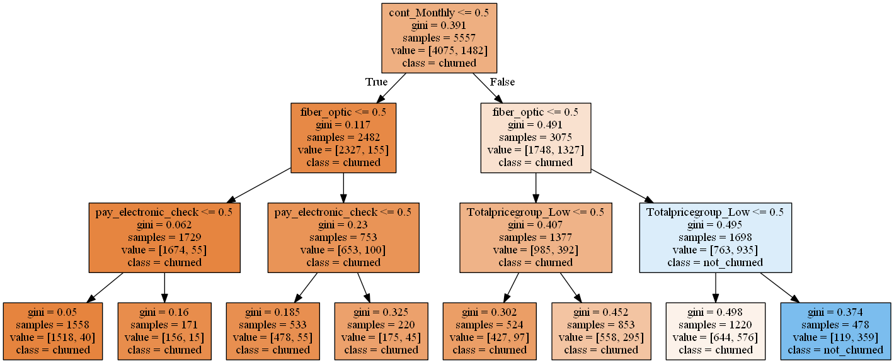
Decision Tree

Slide 8
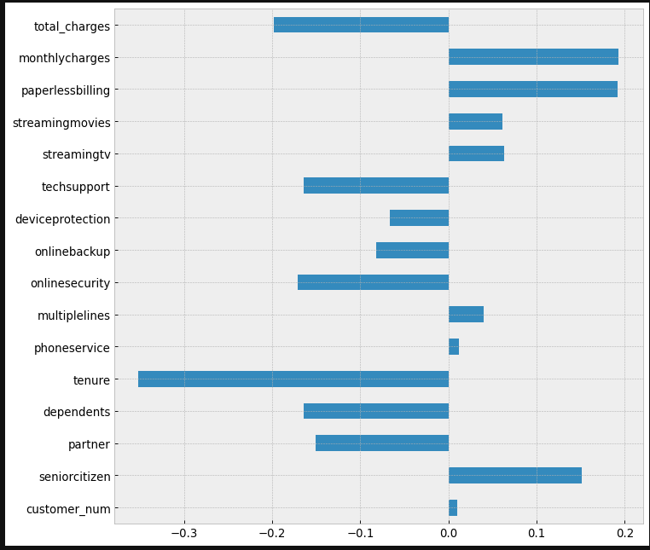
Overall correlation
Based on the top correlations identified here (in circles) we analyzed the following:
Tenure
Charges: Total and Monthly charges (Price Groups)
Services: Techsupport and Online security

Slide 9
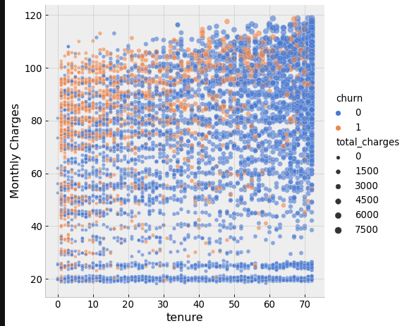
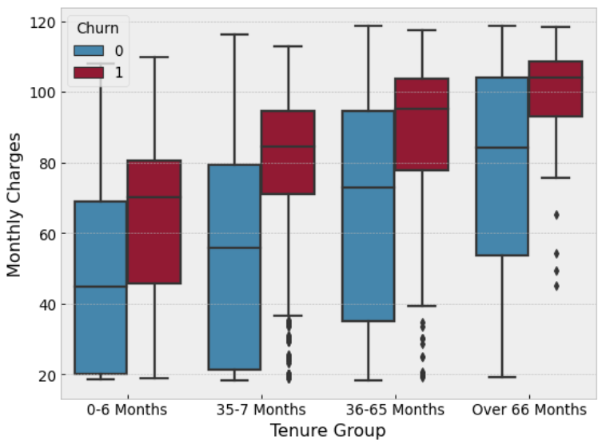
Tenure and Monthly Charges – New Customer with high monthly charges are at high risk of Churn
New Customers with high monthly charges are with the highest risk of churn

Slide 10
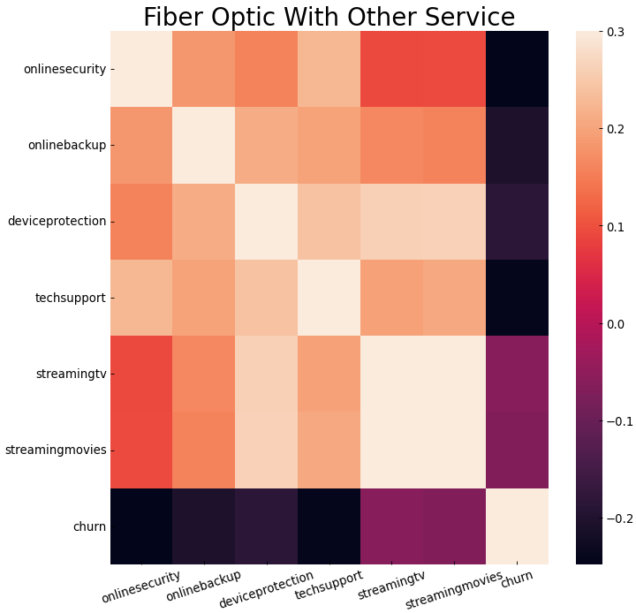
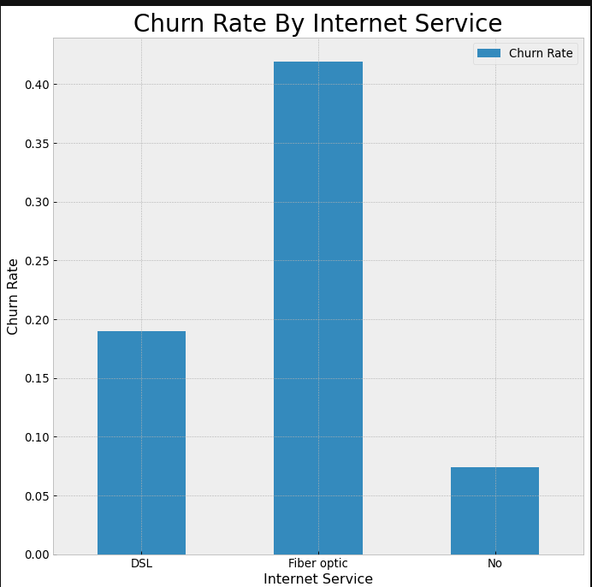
Tech Support is only part of the Internet Services
Fiber Optic includes 4 support services (Online security, Online Backup, Device Protection and Tech Support )
and 2 Streaming Products options (Streaming TV and Streaming Movie)
Conclusion:
63.5% of Fiber Optic without Tech support are in high risk of Churn (63.5%)
Fiber optic are with 41.8 % chances of churn
"Fiber Optic" with services are with lower rate of churned subscribers (more loyal)

Slide 11
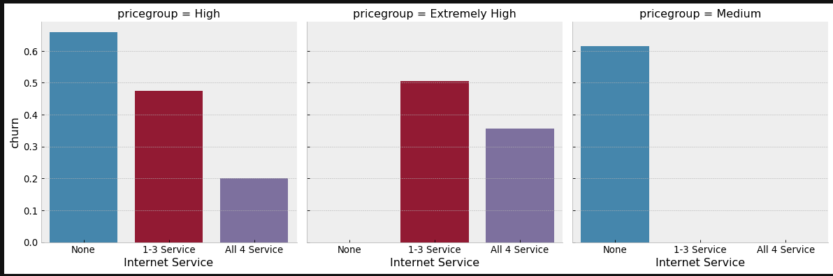
Tech Support - number of services per customer
High and Medium price group without Services are at higher risk of churn
Customers with All 4 services are most loyal

Slide 12


